Slide 1
Profit Analysis
Multiple Linear Regression – 50 Startups Dataset
Tool: Python | Power BI Dataset: 50 Startups CSV Date: June 2026

Slide 2
Dataset Overview
The dataset contains records of 50 startups operating across three US states. Each record captures the financial spending across three categories and the resulting profit.
Feature | Type | Description
R&D Spend | Continuous | Amount spent on Research & Development
Administration | Continuous | Amount spent on Administrative operations
Marketing Spend | Continuous | Amount spent on Marketing strategies
State | Categorical | Location: California, New York, Florida
Profit | Continuous (Target) | Net profit of the startup

Slide 3
Problem Understanding
This report presents a comprehensive Multiple Linear Regression analysis conducted on the 50 Startups dataset to understand how different spending categories – R&D, Administration, and Marketing – influence the profitability of startups across three US states: California, New York, and Florida.
The primary objective is to build a predictive model that estimates profit based on the given input features, evaluate model performance, and derive actionable business insights through statistical analysis and data visualizations.

Slide 4
Regression Analysis
The trained model produced the following regression equation:
Coefficient Interpretation:
R&D Spend (+0.7856): For every ₹1 increase in R&D spending, profit increases by approximately ₹0.79. This is the strongest positive driver of profit.
Administration (–0.0055): A very slight negative coefficient suggesting that administrative overhead has negligible but slightly adverse impact on profit.
Marketing Spend (+0.0325): A modest positive impact; increased marketing spend contributes to profit growth, but less significantly than R&D.
Intercept (48,091.40): The baseline profit when all spending is zero.
Regression Equation Profit = 48,091.40 + 0.7856 × R&D Spend – 0.0055 × Administration + 0.0325 × Marketing Spend

Slide 5
Model Performance Metrics
The model demonstrates strong predictive accuracy as evidenced by the metrics below:
Metric | Value
R² Score (Train) | 0.95
R² Score (Test) | 0.92
Mean Absolute Error (MAE) | 6,310
Root Mean Square Error (RMSE) | 7,800
The R² score of 0.95 on training data and 0.92 on test data indicates the model generalizes well and explains approximately 92% of the variance in profit on unseen data. The difference between train and test R² is minimal (0.03), confirming there is no significant overfitting

Slide 6
Profit Predictions for Given Inputs
or Given Inputs
Using the trained regression model, profit was predicted for the following two input records as specified in the task:
Both predicted profits fall in the ₹70,000–₹71,000 range, consistent with startup profiles that have moderate R&D investment (~₹22,000–24,000) and mid-range marketing spend.
R&D Spend | Administration | Marketing Spend | Predicted Profit
23,940.93 | 96,489.63 | 1,37,001.10 | 70,818.24
21,892.92 | 81,910.77 | 1,64,270.70 | 70,174.34

Slide 7
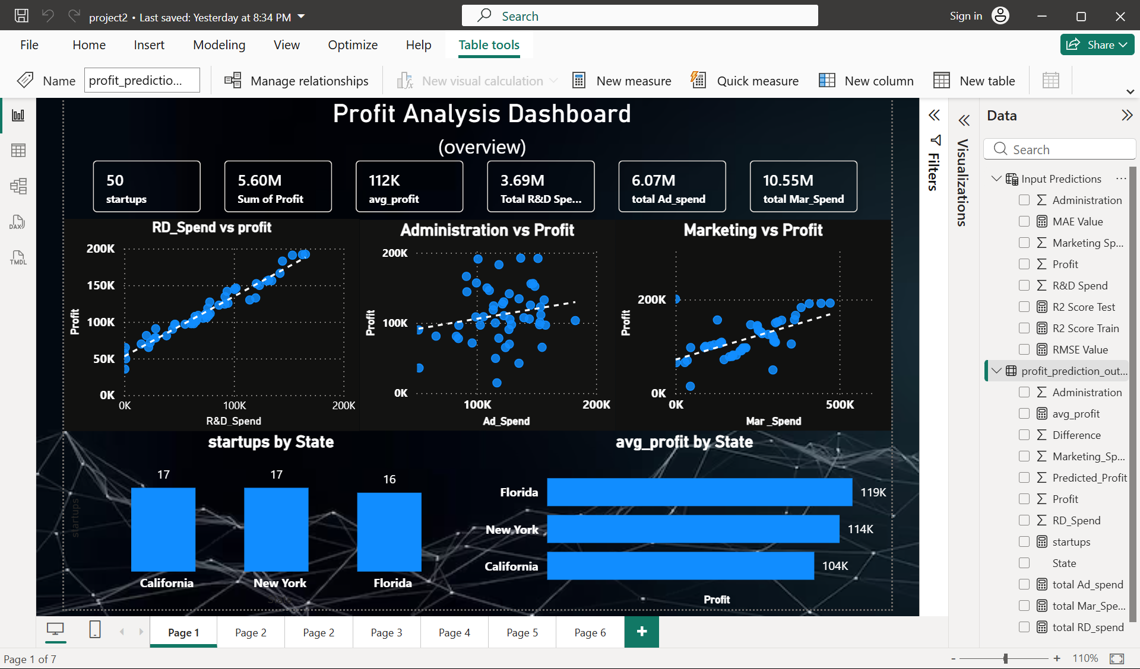

Slide 8
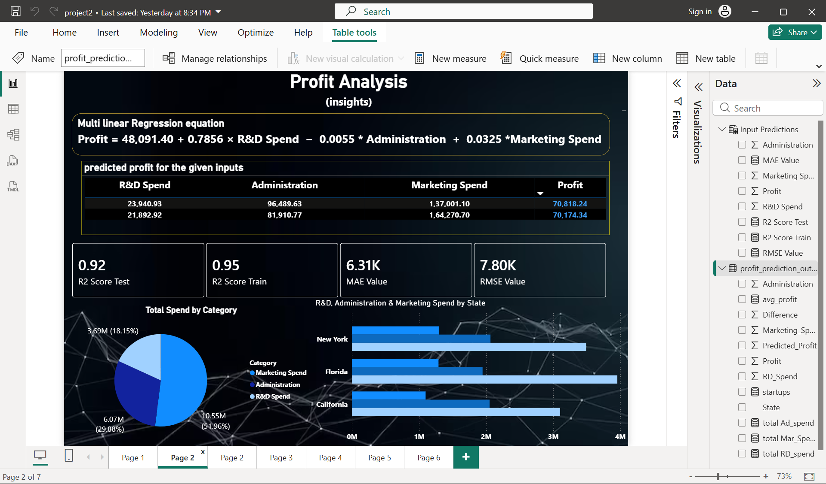

Slide 9
Key Insights
R&D Spend is the strongest predictor of profit with a coefficient of 0.7856 – every additional dollar spent on R&D generates nearly 79 cents in profit.
Administration spend has a negligible and slightly negative impact (–0.0055) – it does not contribute to revenue generation.
Marketing has a moderate positive effect (+0.0325) but returns are lower per dollar compared to R&D.
Florida startups show the highest average profitability despite being the smallest cohort.
The model explains 92% of profit variance on unseen data (R² = 0.92), indicating very high reliability.
Total marketing spend (10.55M) far exceeds R&D spend (3.69M), yet R&D drives more value per rupee.

Slide 10
Recommendations to the Company
Increase R&D Investment: Prioritize R&D budget as it directly drives profitability. A 10% increase in R&D could yield approximately 7.86% improvement in profit.
Optimize Administration Costs: Since admin spend shows a slight negative coefficient, companies should streamline administrative overhead through automation or process optimization.
Reassess Marketing Allocation: While marketing positively impacts profit, the return per dollar is significantly lower than R&D. Marketing spend should be optimized (quality over quantity).
Target Florida for Expansion: Florida startups show the highest average profit, suggesting market conditions. New investment or expansion in this state may yield better returns.
Use Predictive Model for Budgeting: The regression model (R² = 0.92) is reliable enough for quarterly profit planning. Input planned spend values to get projected profit estimates.
Focus on High-R&D Startups: Startups in the top quartile of R&D spend consistently achieve profits above 1,50,000, reinforcing the R&D-profit relationship.

Slide 11
Thank you

